Slide 1
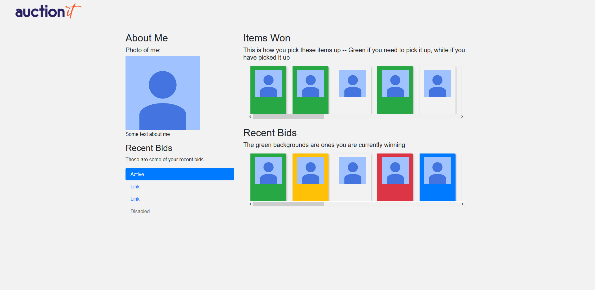
AUCTION.IT
USER PAGE CONTENT
The purpose of this “medium-fidelity” prototype is to showcase the upcoming navigation bar functionality. It builds on our current high-fidelity prototype.

Slide 2




John Smith
Log out
USER PAGE CONTENT
Home
Search

Slide 3
John Smith
Log out
Home

